Slide 1
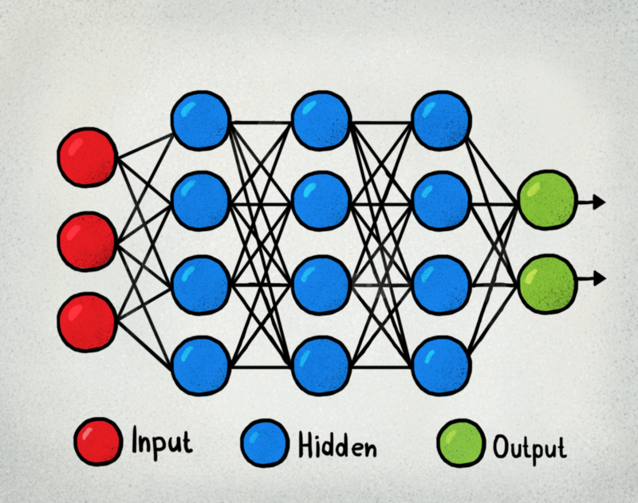
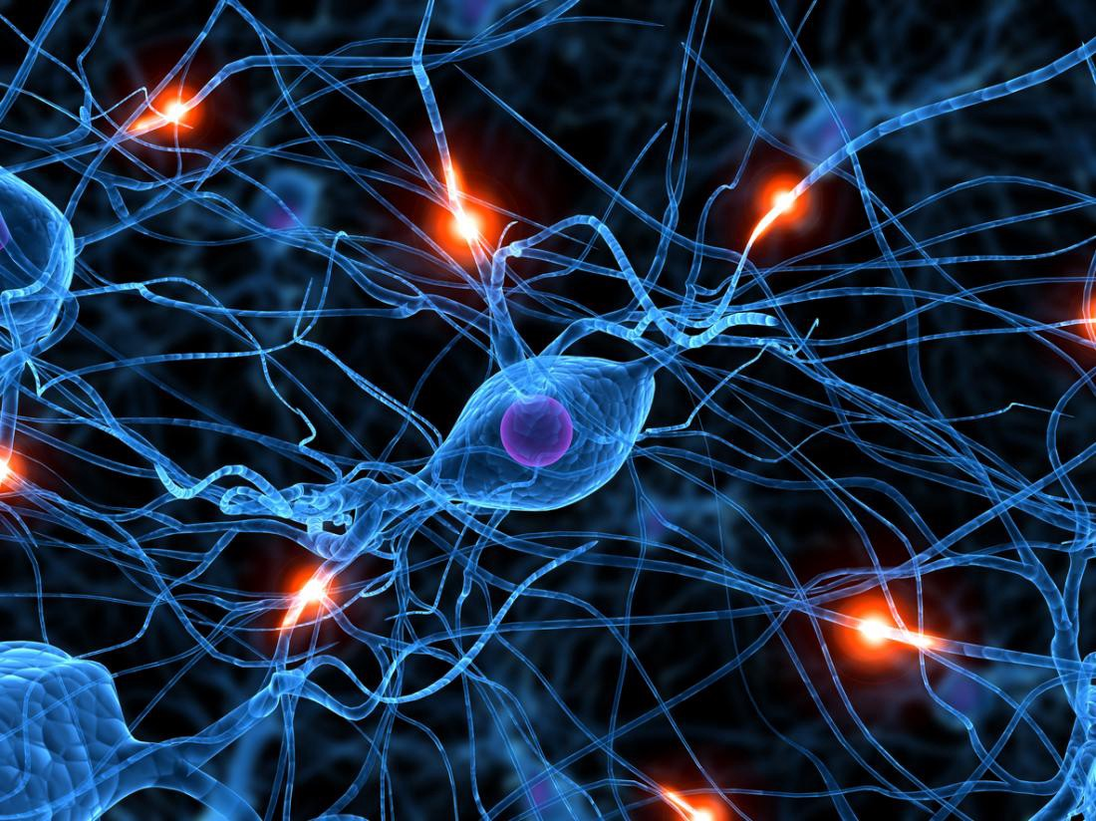
CSE 3521: Neural Networks
OR

Slide 2
Today
Learning “deeper” networks beyond one-layer perceptrons
Losses and gradients
Back-propagation
Stochastic gradient descent
Training particulars
Regularization or weight decay
Discriminative vs. generative models

Slide 3
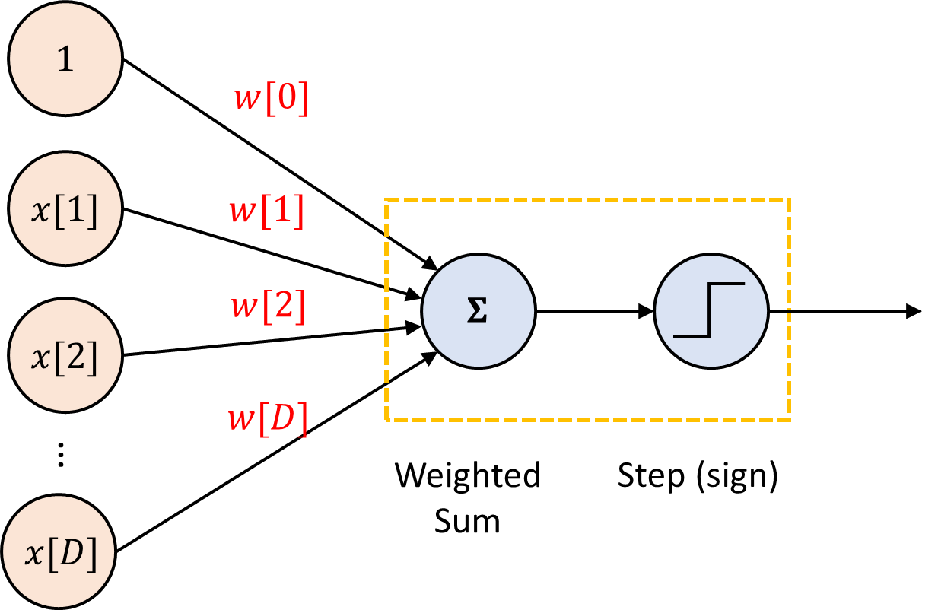

Perceptron Algorithm
Let $x∈ℝ^{D}$ and $w$ $∈ℝ^{D}$ ($b$ is merged into $w$), $y∈\{−1,1\}$
Initialize weight vector $w=0$
Loop for T iterations
Loop for all training examples $x_{n}$ (random order!)
Predict ${\hat{y}}_{n}=sign\left(w^{T}x_{n}\right)$
If ${\hat{y}}_{n}≠y_{n}$
Update: $w←w+η(y_{n}x_{n})$

Slide 4
Multi-layer perceptron
How to learn?
Perceptron algorithm?
Only look at one instance a time
Can update only a single perceptron
Not converge for not linear separable data

Slide 5
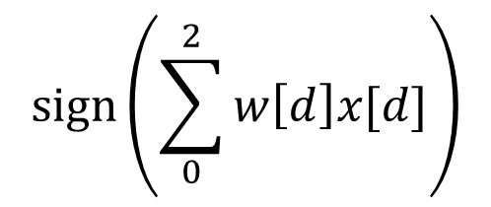






Why multiple layers?
$$sign\left(\sum_{0}^{2}{w\left[d\right]x[d]}\right)$$
$$1$$
(0, 1)
$$w[0]$$
(1, 0)
$$x[1]$$
(-1, 0)
$$w[1]$$
$$x[2]$$
$$w[2]$$
(0, -1)
Impossible to classify the 4 points correctly!

Slide 6
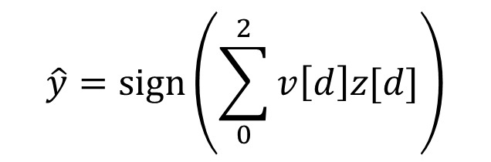










Why multiple layers?
$$\hat{y}=sign\left(\sum_{0}^{2}{v\left[d\right]z[d]}\right)$$
$$1$$
$$1$$
$$v[0]$$
(0, 1)
$$v[1]$$
$$x[1]$$
$$z[1]$$
$$\hat{y}$$
(1, 0)
$$v[2]$$
(-1, 0)
$$x[2]$$
$$z[2]$$
(0, -1)

Slide 7





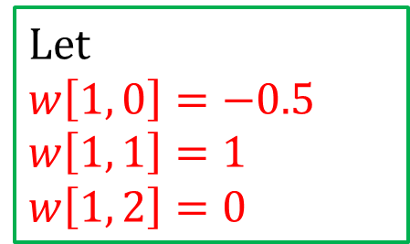
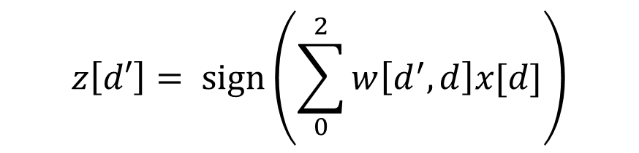
Why multiple layers?
$$z\left[1\right]=−1$$
$$z\left[1\right]=1$$
$$1$$
$$w[1, 0]$$
(0, 1)
$$w[1, 1]$$
Let
$$w\left[1, 0\right]=−0.5$$
$$w\left[1, 1\right]=1$$
$w\left[1, 2\right]=0$
$$x[1]$$
$$z[1]$$
(1, 0)
$$w[1, 2]$$
(-1, 0)
$$x[2]$$
(0, -1)
$$z\left[d′\right]= sign\left(\sum_{0}^{2}{w\left[d^{′}, d\right]x[d]}\right)$$

Slide 8





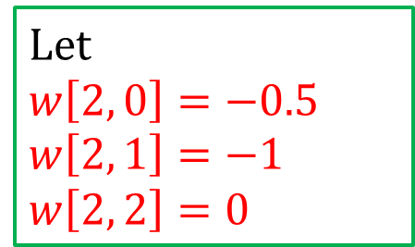
Why multiple layers?
$$1$$
(0, 1)
$$w[2, 0]$$
Let
$$w\left[2, 0\right]=−0.5$$
$$w\left[2, 1\right]=−1$$
$w\left[2, 2\right]=0$
$$x[1]$$
(1, 0)
$$w[2, 1]$$
(-1, 0)
$$x[2]$$
$$z[2]$$
$$w[2, 2]$$
(0, -1)
$$z\left[d′\right]= sign\left(\sum_{0}^{2}{w\left[d^{′}, d\right]x[d]}\right)$$
$$z\left[2\right]=1$$
$$z\left[2\right]=−1$$

Slide 9
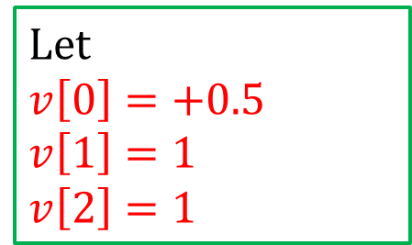
Why multiple layers?
$$\hat{y}=sign\left(\sum_{0}^{2}{v\left[d\right]z[d]}\right)$$
$$z\left[1\right]=−1$$
$$z\left[1\right]=1$$
$$1$$
$$1$$
$$v[0]$$
(0, 1)
$$v[1]$$
$$x[1]$$
$$z[1]$$
$$\hat{y}$$
(1, 0)
$$v[2]$$
(-1, 0)
$$x[2]$$
$$z[2]$$
Let
$$v\left[0\right]=+0.5$$
$$v\left[1\right]=1$$
$v\left[2\right]=1$
(0, -1)
$$z\left[2\right]=1$$
$$z\left[2\right]=−1$$

Slide 10



Why multiple layers?
$$\hat{y}=sign\left(\sum_{0}^{2}{v\left[d\right]z[d]}\right)$$
$$1$$
$$1$$
$$v[0]$$
(0, 1)
$$v[1]$$
$$x[1]$$
$$z[1]$$
$$\hat{y}$$
(1, 0)
$$v[2]$$
(-1, 0)
$$x[2]$$
$$z[2]$$
Let
$$v\left[0\right]=+0.5$$
$$v\left[1\right]=1$$
$v\left[2\right]=1$
$$\hat{y}=1$$
$$\hat{y}=1$$
(0, -1)
$$\hat{y}=−1$$

Slide 11
Today
Learning “deeper” networks beyond one-layer perceptrons
Losses and gradients
Back-propagation
Stochastic gradient descent
Training particulars
Regularization or weight decay
Discriminative vs. generative models

Slide 12











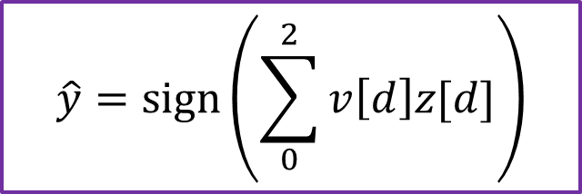
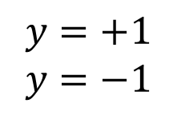
Losses: $\hat{y}$ vs. $y$
$$y=+1$$
$$y=−1$$
$$1$$
$$1$$
$$v[0]$$
(0, 1)
(1, 0)
$$v[1]$$
$$x[1]$$
$$z[1]$$
$$\hat{y}$$
$$v[2]$$
(-1, 0)
$$x[2]$$
$$z[2]$$
(0, -1)
$$\hat{y}=sign\left(\sum_{0}^{2}{v\left[d\right]z[d]}\right)$$

Slide 13
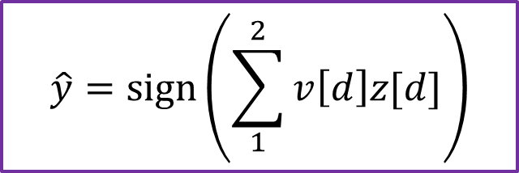
Temporally take out “1” for simplicity
$$y=+1$$
$$y=−1$$
(0, 1)
(1, 0)
$$v[1]$$
$$x[1]$$
$$z[1]$$
$$\hat{y}$$
$$v[2]$$
(-1, 0)
$$x[2]$$
$$z[2]$$
(0, -1)
$$\hat{y}=sign\left(\sum_{1}^{2}{v\left[d\right]z[d]}\right)$$

Slide 14
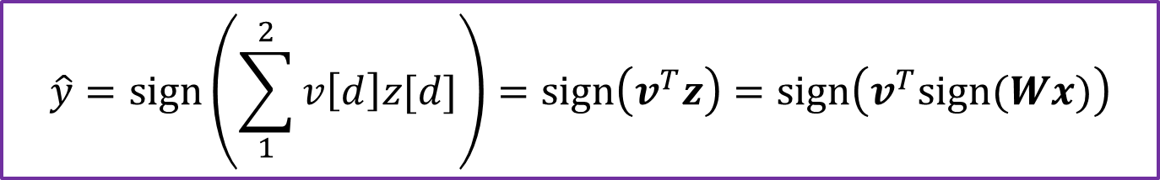

Re-written with linear algebra
$$y=+1$$
$$y=−1$$
(0, 1)
(1, 0)
$$v[1]$$
$$x[1]$$
$$z[1]$$
$$\hat{y}$$
$$v[2]$$
(-1, 0)
$$x[2]$$
$$z[2]$$
(0, -1)
$$\hat{y}=sign\left(\sum_{1}^{2}{v\left[d\right]z[d]}\right)=sign\left(v^{T}z\right)=sign\left(v^{T}sign(Wx)\right)$$
$\left[\begin{aligned}z[1] \\ z[2]\end{aligned}\right]=sign(\left[\begin{matrix}w[1,1] & w[1, 2] \\ w[2,1] & w[2,2]\end{matrix}\right]\left[\begin{aligned}x[1] \\ x[2]\end{aligned}\right]$)

Slide 15
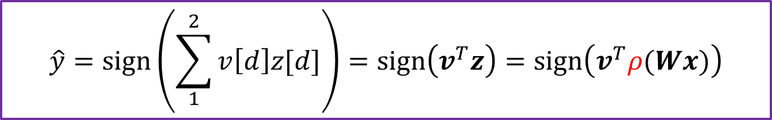

Using sigmoid for inner layers
$$y=+1$$
$$y=−1$$
(0, 1)
(1, 0)
$$v[1]$$
$$x[1]$$
$$z[1]$$
$$\hat{y}$$
$$v[2]$$
(-1, 0)
$$x[2]$$
$$z[2]$$
(0, -1)
$$\hat{y}=sign\left(\sum_{1}^{2}{v\left[d\right]z[d]}\right)=sign\left(v^{T}z\right)=sign\left(v^{T}ρ(Wx)\right)$$
$$\left[\begin{aligned}z[1] \\ z[2]\end{aligned}\right]=ρ(\left[\begin{matrix}w\left[1,1\right] & w\left[1, 2\right] \\ w\left[2,1\right] & w\left[2,2\right]\end{matrix}\right]\left[\begin{aligned}x\left[1\right] \\ x\left[2\right]\end{aligned}\right])$$

Slide 16
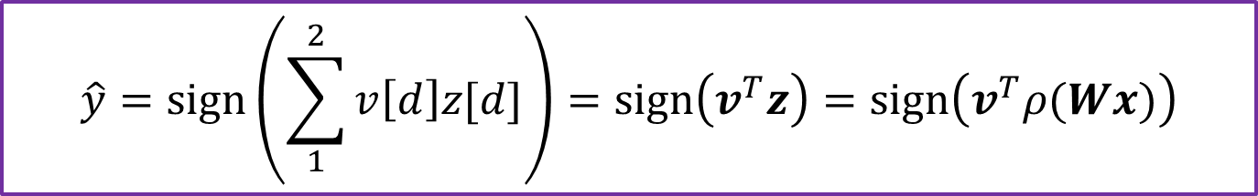
What are the parameters?
$$\hat{y}=sign\left(\sum_{1}^{2}{v\left[d\right]z[d]}\right)=sign\left(v^{T}z\right)=sign\left(v^{T}ρ(Wx)\right)$$

Slide 17

What are the parameters?
$$\hat{y}=sign\left(\sum_{1}^{2}{v\left[d\right]z[d]}\right)=sign\left(v^{T}z\right)=sign\left(v^{T}ρ(Wx)\right)$$
$Answer: v$, $W$

Slide 18










Losses and gradients for one data instance
$$l\left(y,\hat{y}\right)$$
$$v[1]$$
$$y=+1$$
$$y=−1$$
$$x[1]$$
$$z[1]$$
$$\hat{y}$$
$$y$$
$$v[2]$$
(1, 0)
$$x[2]$$
$$z[2]$$
$$\hat{y}=sign\left(\sum_{1}^{2}{v\left[d\right]z[d]}\right)=sign\left(v^{T}z\right)=sign\left(v^{T}ρ(Wx)\right)$$
$$l\left(y,\hat{y}\right)≈l(y,v^{T}ρ(Wx))$$
For example, logistic loss (binary entropy loss): $$l\left(y,v^{T}ρ\left(Wx\right)\right)=−y×\log{ρ{(v}^{T}ρ\left(Wx\right))}−(1−y)×\log{(1−ρ{(v}^{T}ρ\left(Wx\right)))}$$

Slide 19
Losses and gradients for one data instance
$$l\left(y,\hat{y}\right)$$
$$v[1]$$
$$y=+1$$
$$y=−1$$
$$x[1]$$
$$z[1]$$
$$\hat{y}$$
$$y$$
$$v[2]$$
(1, 0)
$$x[2]$$
$$z[2]$$
$$l\left(y,\hat{y}\right)≈l(y,v^{T}ρ(Wx))$$
$$∇_{v}l\left(y,\hat{y}\right)=∇_{v} l\left(y,v^{T}ρ\left(Wx\right)\right)=∇_{v} l(y,v^{T}z)$$
$$∇_{W}l\left(y,\hat{y}\right)?$$

Slide 20
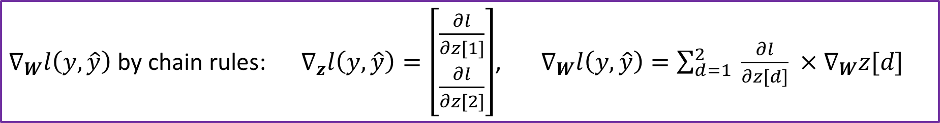

Losses and gradients for one data instance
$$l\left(y,\hat{y}\right)$$
$$y=+1$$
$$y=−1$$
$$x[1]$$
$$z[1]$$
$$\hat{y}$$
$$y$$
$$W$$
(1, 0)
$$x[2]$$
$$z[2]$$
$$l\left(y,\hat{y}\right)≈l(y,v^{T}ρ(Wx))$$
$$∇_{v}l\left(y,\hat{y}\right)=∇_{v} l\left(y,v^{T}ρ\left(Wx\right)\right)=∇_{v} l(y,v^{T}z)$$
$∇_{W}l\left(y,\hat{y}\right)$ by chain rules: $∇_{z}l\left(y,\hat{y}\right)=\left[\begin{aligned}\frac{∂l}{∂z[1]} \\ \frac{∂l}{∂z[2]}\end{aligned}\right]$, $∇_{W}l\left(y,\hat{y}\right)=\sum_{d=1}^{2}{ \frac{∂l}{∂z[d]} ×∇_{W}z[d]}$

Slide 21
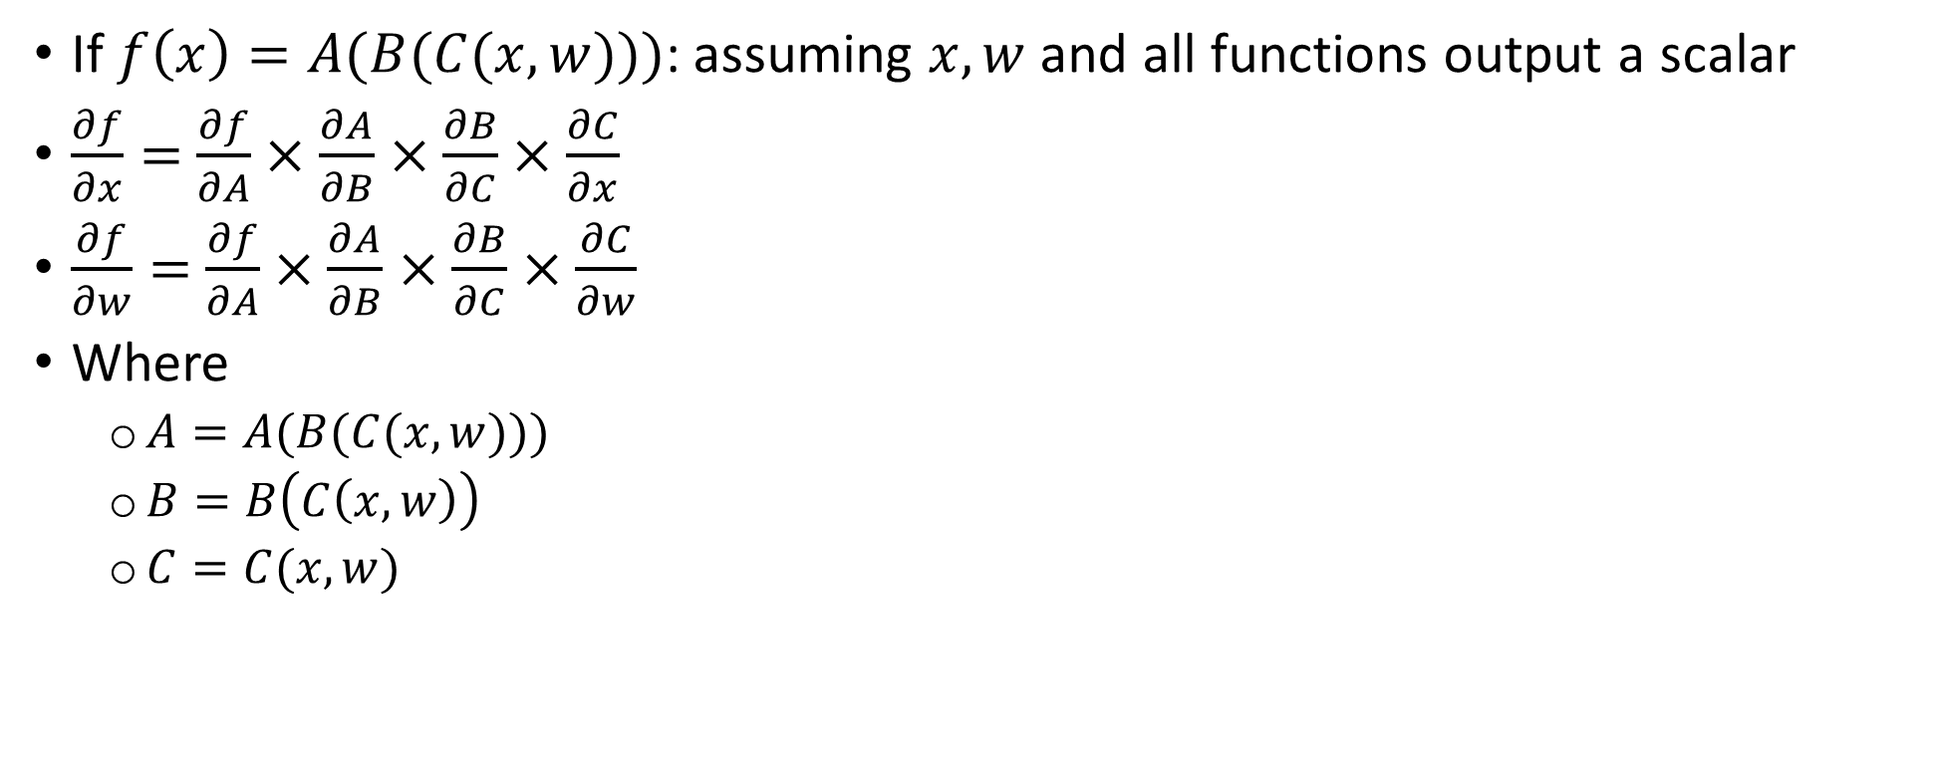
Review chain rules
If $f\left(x\right)=A(B(C(x, w)))$: assuming $x,w$ and all functions output a scalar
$\frac{∂f}{∂x}=$ $\frac{∂f}{∂A}×\frac{∂A}{∂B}$ $×\frac{∂B}{∂C}×\frac{∂C}{∂x}$
$\frac{∂f}{∂w}=$ $\frac{∂f}{∂A}×\frac{∂A}{∂B}$ $×\frac{∂B}{∂C}×\frac{∂C}{∂w}$
Where
$A=A(B(C(x, w)))$
$B=B\left(C\left(x, w\right)\right)$
$C=C(x, w)$

Slide 22

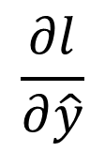






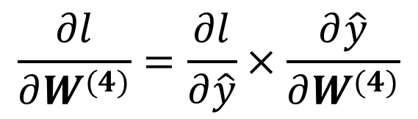



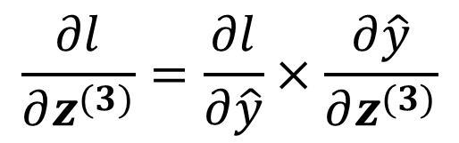
Backpropagation
$$x$$
$$z^{(1)}$$
$$z^{(2)}$$
$$z^{(3)}$$
$$\hat{y}$$
$$y$$
$$\frac{∂l}{∂z^{(3)}}=\frac{∂l}{∂\hat{y}}×\frac{∂\hat{y}}{∂z^{(3)}}$$
$$\frac{∂l}{∂\hat{y}}$$
$$\frac{∂l}{∂W^{(4)}}=\frac{∂l}{∂\hat{y}}×\frac{∂\hat{y}}{∂W^{(4)}}$$
$$W^{(1)}$$
$$W^{(2)}$$
$$W^{(3)}$$
$$W^{(4)}$$

Slide 23
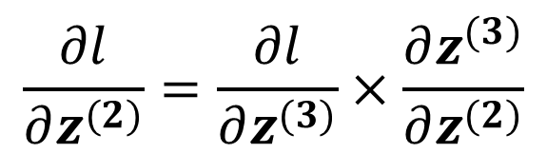
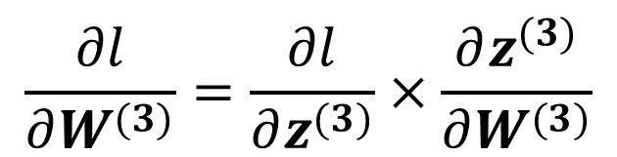
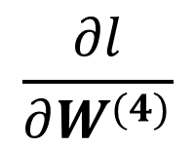
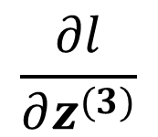
Backpropagation
$$x$$
$$z^{(1)}$$
$$z^{(2)}$$
$$z^{(3)}$$
$$\hat{y}$$
$$y$$
$$\frac{∂l}{∂z^{(2)}}=\frac{∂l}{∂z^{(3)}}×\frac{∂z^{(3)}}{∂z^{(2)}}$$
$$\frac{∂l}{∂z^{(3)}}$$
$$\frac{∂l}{∂\hat{y}}$$
$$\frac{∂l}{∂W^{(3)}}=\frac{∂l}{∂z^{(3)}}×\frac{∂z^{(3)}}{∂W^{(3)}}$$
$$\frac{∂l}{∂W^{(4)}}$$
$$W^{(1)}$$
$$W^{(2)}$$
$$W^{(3)}$$
$$W^{(4)}$$

Slide 24
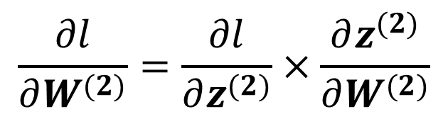
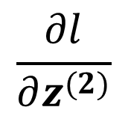
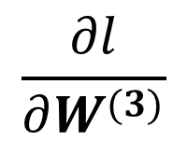
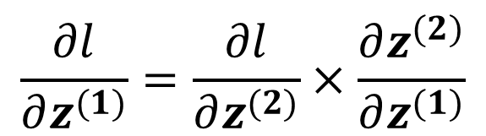
Backpropagation
$$x$$
$$z^{(1)}$$
$$z^{(2)}$$
$$z^{(3)}$$
$$\hat{y}$$
$$y$$
$$\frac{∂l}{∂z^{(1)}}=\frac{∂l}{∂z^{(2)}}×\frac{∂z^{(2)}}{∂z^{(1)}}$$
$$\frac{∂l}{∂z^{(2)}}$$
$$\frac{∂l}{∂z^{(3)}}$$
$$\frac{∂l}{∂\hat{y}}$$
$$\frac{∂l}{∂W^{(2)}}=\frac{∂l}{∂z^{(2)}}×\frac{∂z^{(2)}}{∂W^{(2)}}$$
$$\frac{∂l}{∂W^{(3)}}$$
$$\frac{∂l}{∂W^{(4)}}$$
$$W^{(1)}$$
$$W^{(2)}$$
$$W^{(3)}$$
$$W^{(4)}$$

Slide 25
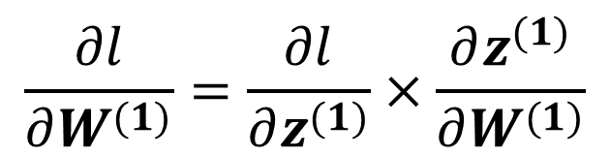
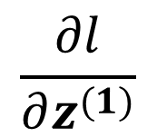
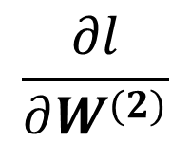
Backpropagation
$$x$$
$$z^{(1)}$$
$$z^{(2)}$$
$$z^{(3)}$$
$$\hat{y}$$
$$y$$
$$\frac{∂l}{∂z^{(1)}}$$
$$\frac{∂l}{∂z^{(2)}}$$
$$\frac{∂l}{∂z^{(3)}}$$
$$\frac{∂l}{∂\hat{y}}$$
$$\frac{∂l}{∂W^{(1)}}=\frac{∂l}{∂z^{(1)}}×\frac{∂z^{(1)}}{∂W^{(1)}}$$
$$\frac{∂l}{∂W^{(2)}}$$
$$\frac{∂l}{∂W^{(3)}}$$
$$\frac{∂l}{∂W^{(4)}}$$
$$W^{(1)}$$
$$W^{(2)}$$
$$W^{(3)}$$
$$W^{(4)}$$

Slide 26
Illustration

Slide 27

Backpropagation
When it is not a scalar:
$\frac{∂l}{∂z^{(2)}}=\frac{∂l}{∂z^{(3)}}×\frac{∂z^{(3)}}{∂z^{(2)}}$ → $\frac{∂l}{∂z^{(2)}}=\sum_{d=1}^{D}{\frac{∂l}{∂z^{(3)}[d]}×\frac{∂z^{(3)}[d]}{∂z^{(2)}}}$
$\frac{∂l}{∂W^{(3)}}=\frac{∂l}{∂z^{(3)}}×\frac{∂z^{(3)}}{∂W^{(3)}}$ →$\frac{∂l}{∂W^{(3)}}=\sum_{d=1}^{D}{\frac{∂l}{∂z^{(3)}[d]}×\frac{∂z^{(3)}[d]}{∂W^{(3)}}}$

Slide 28
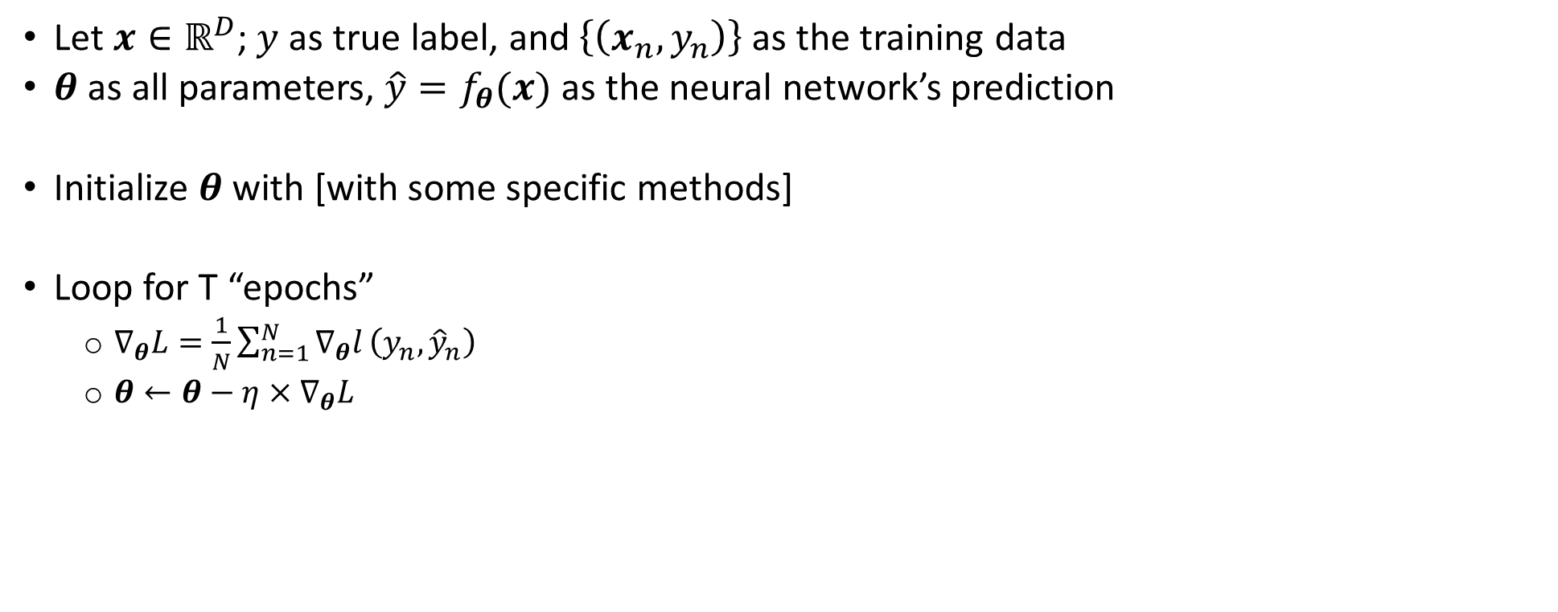
Training a neural network: gradient descent
Let $x∈ℝ^{D}$; $y$ as true label, and $\left\{\left(x_{n},y_{n}\right)\right\}$ as the training data
$θ$ as all parameters, $\hat{y}=f_{θ}(x)$ as the neural network’s prediction
Initialize $θ$ with [with some specific methods]
Loop for T “epochs”
$∇_{θ}L=\frac{1}{N}\sum_{n=1}^{N}{∇_{θ}l}\left(y_{n},{\hat{y}}_{n}\right)$
$θ←θ−η×∇_{θ}L$

Slide 29
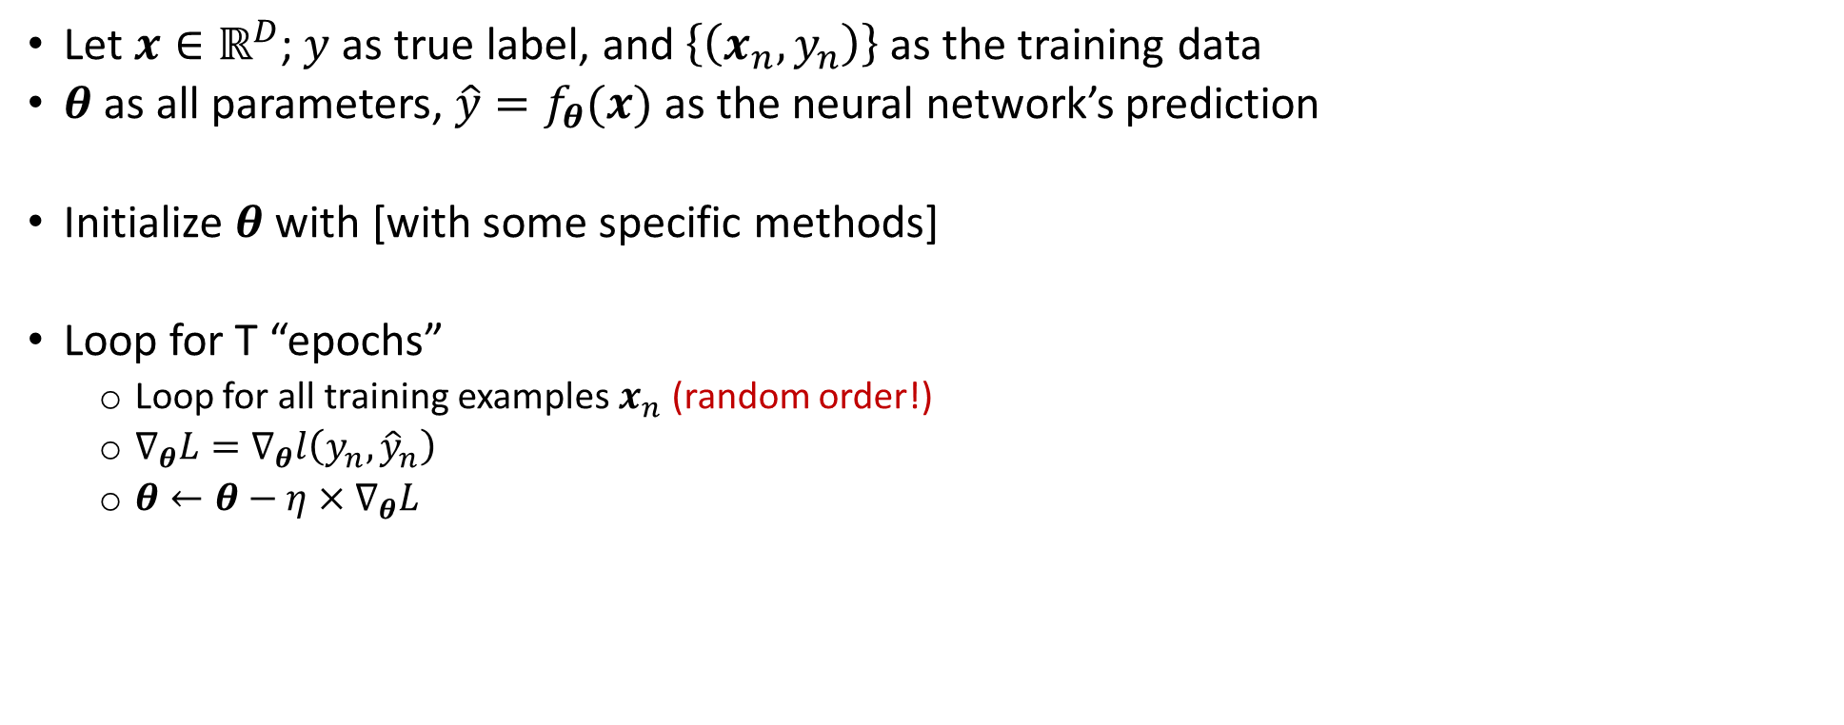
Stochastic gradient descent
Let $x∈ℝ^{D}$; $y$ as true label, and $\left\{\left(x_{n},y_{n}\right)\right\}$ as the training data
$θ$ as all parameters, $\hat{y}=f_{θ}(x)$ as the neural network’s prediction
Initialize $θ$ with [with some specific methods]
Loop for T “epochs”
Loop for all training examples $x_{n}$ (random order!)
$∇_{θ}L=∇_{θ}l\left(y_{n},{\hat{y}}_{n}\right)$
$θ←θ−η×∇_{θ}L$

Slide 30
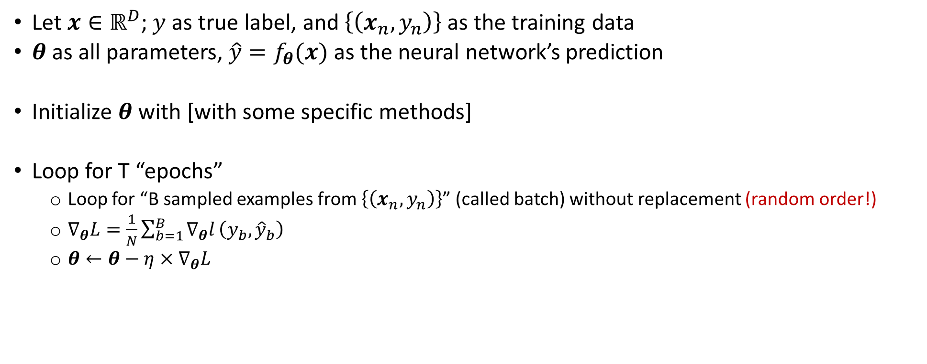
“Mini-batch” Stochastic gradient descent
Let $x∈ℝ^{D}$; $y$ as true label, and $\left\{\left(x_{n},y_{n}\right)\right\}$ as the training data
$θ$ as all parameters, $\hat{y}=f_{θ}(x)$ as the neural network’s prediction
Initialize $θ$ with [with some specific methods]
Loop for T “epochs”
Loop for “B sampled examples from $\left\{\left(x_{n},y_{n}\right)\right\}$” (called batch) without replacement (random order!)
$∇_{θ}L=\frac{1}{N}\sum_{b=1}^{B}{∇_{θ}l}\left(y_{b},{\hat{y}}_{b}\right)$
$θ←θ−η×∇_{θ}L$

